Slide 1
Presentation Outline
D2C algorithm
Results shown in the paper
Tensegrity robots examples

Slide 2
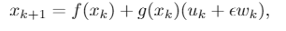
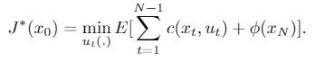
Decoupled Data-based Control (D2C) Algorithm
For the nonlinear stochastic system:
Solve the optimal control problem:
Step 1: Open-loop Optimization
Step 2: System Identification
Step 3: Calculate LQR Gain

Slide 3
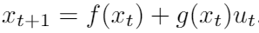
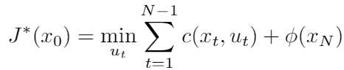
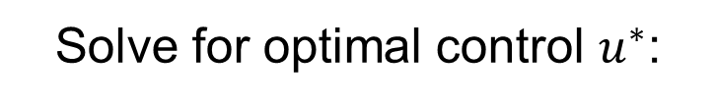
Open-loop Optimization
Deterministic system:
Solve for optimal control $u^{∗}$:
Initial control sequence $u$
Initial control sequence 𝑢
$$dJ= \frac{d\overline{J}}{du}du$$
𝑑𝐽= (𝑑𝐽 ̅)/𝑑𝑢 𝑑𝑢
Update $u$
Update 𝑢
Nominal cost $\overline{J}$
Nominal cost 𝐽 ̅
Perturb $u$ and simulate rollouts
Perturb 𝑢 and simulate rollouts

Slide 4
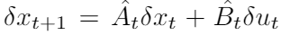
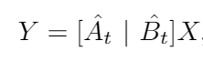
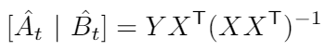
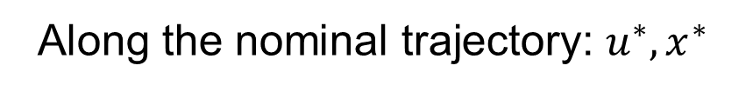
System Identification
Linearize the system as:
Along the nominal trajectory: $u^{∗},x^{∗}$
$$x_{t}= x_{t}^{∗}+δxt$$
$$u_{t}= u_{t}^{∗}+δut$$
𝑥_𝑡= 𝑥_𝑡^∗+𝛿𝑥_{𝑡}
𝑢_𝑡= 𝑢_𝑡^∗+𝛿𝑢_{𝑡}
Simulate one step to get $x_{t+1}$
Simulate one step to get 𝑥_(𝑡+1)
$δx_{t+1}=x_{t+1}$-$x_{t+1}^{∗}$
𝛿𝑥_(𝑡+1)=𝑥_(𝑡+1)-𝑥_(𝑡+1)^∗

Slide 5
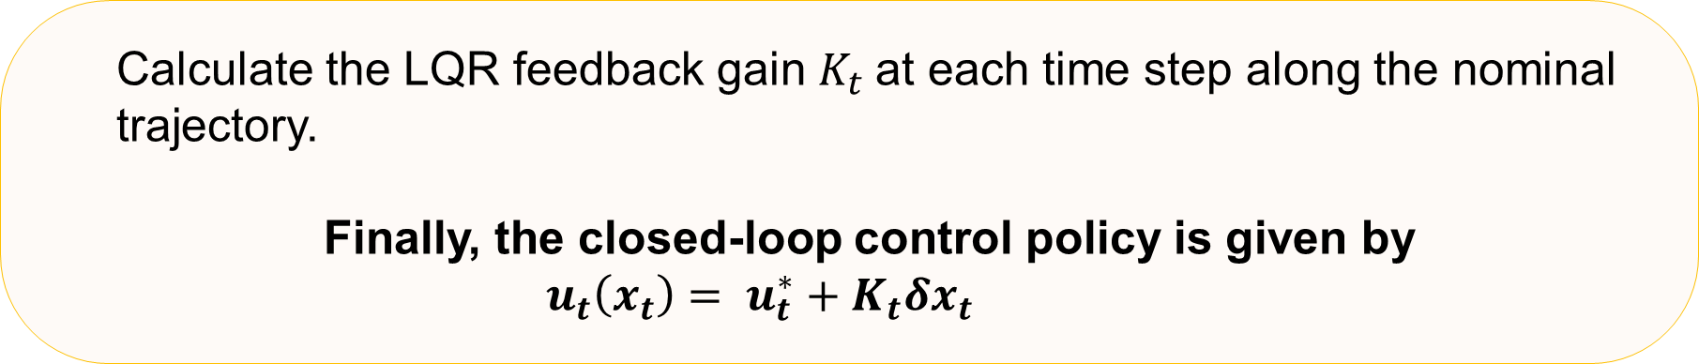
LQR Gain
Calculate the LQR feedback gain $K_{t}$at each time step along the nominal trajectory.
Finally, the closed-loop control policy is given by
$u_{t}\left(x_{t}\right)= u_{t}^{∗}+K_{t}δx_{t}$

Slide 6
Tasks

Slide 7
Apply both D2C and shape control to tensegrity models
Compare the D2C algorithm with the model-based shape control method
Test the performance of D2C closed-loop control policy

Slide 8
Experimental Results

Slide 9
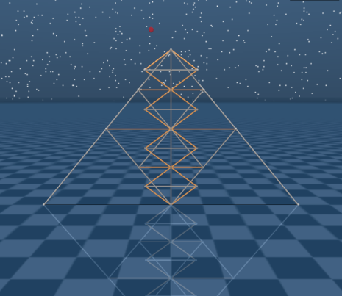
T2D1 Reacher
A 2-dimensional model built by combining 22 bars and 22 strings. It has 14 degrees of freedom and 22 control channels on the strings. The task is to move the top tip into the target.

Slide 10
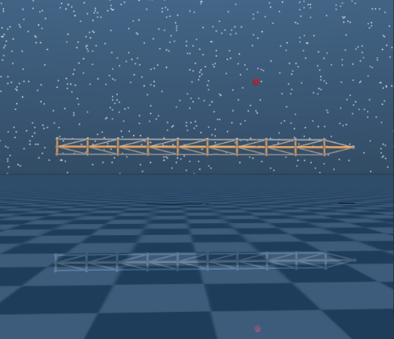
Arm
A 2-dimensional robotic arm composed of 10 T-shape elements. It has 9 degrees of freedom and 38 control channels.

Slide 11
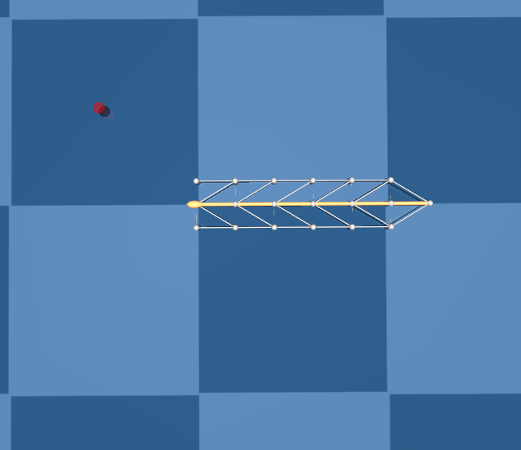
6-link Swimmer
This model is required to swim into the target. It’s a planner model that has 8 degrees of freedom and 22 control channels.

Slide 12
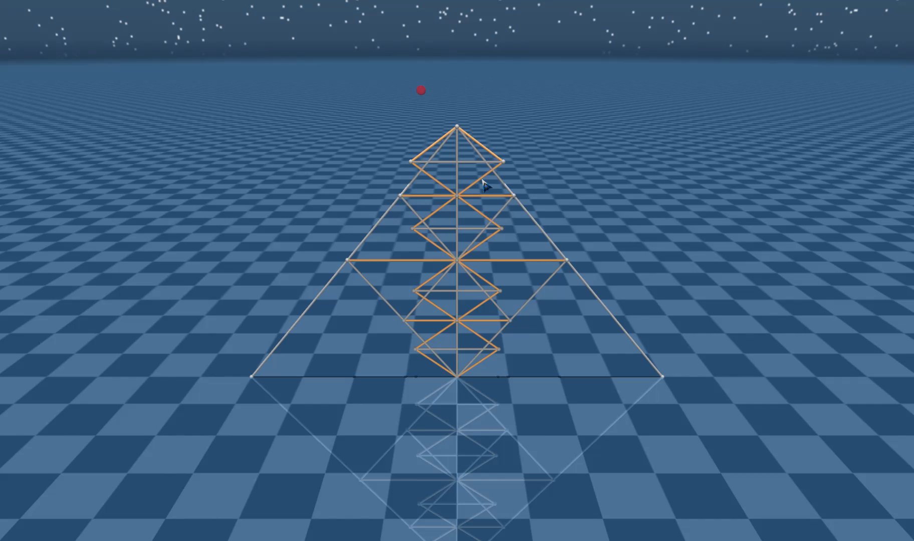
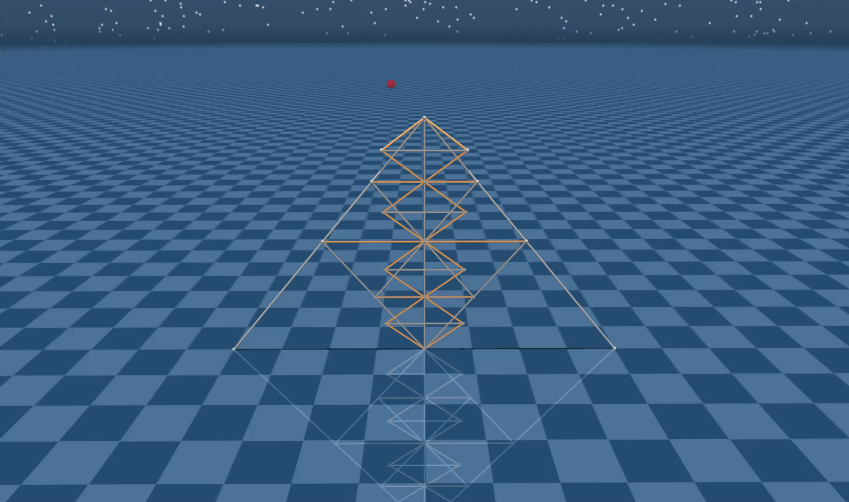
Model-based policy VS. D2C closed-loop policy
T2D1 Tensegrity Model
Red Ball: Target
Noise level: 20%
Faster
Slower
Model-based shape control
D2C closed-loop policy

Slide 13
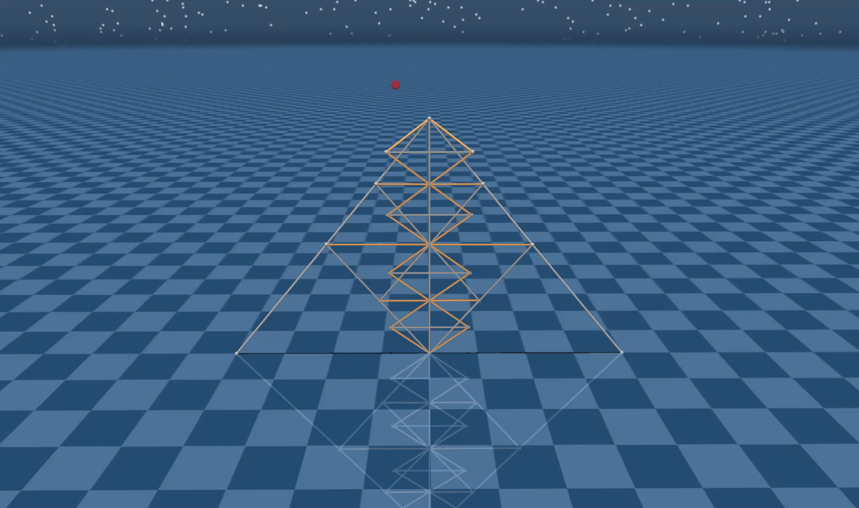
D2C applied on T2D1 Tensegrity Model
Noise level: 20%
Red Ball: Target
Failed
Succeeded
D2C open-loop policy (no feedback)
D2C closed-loop policy

Slide 14
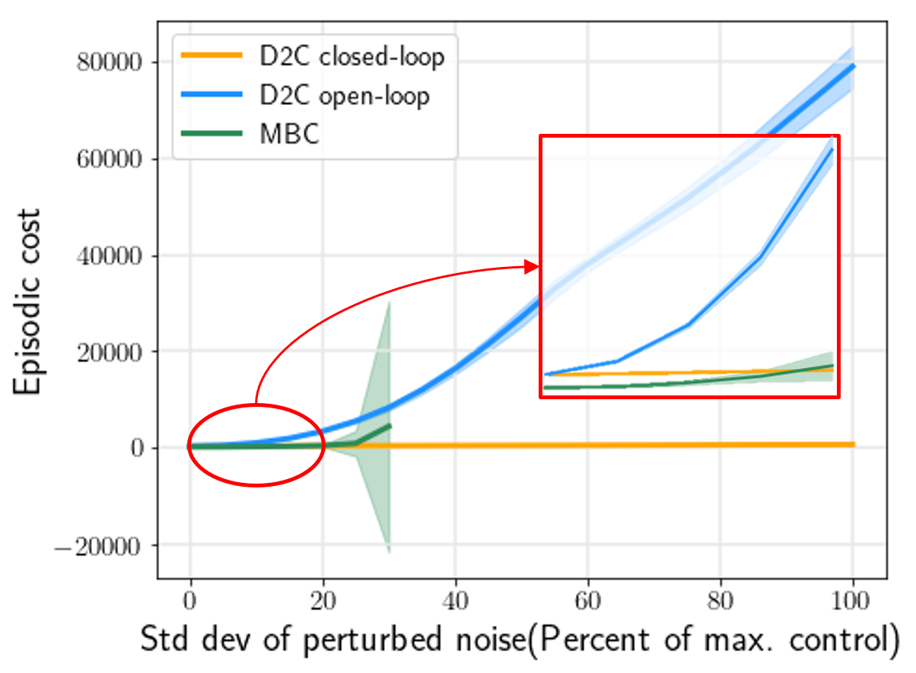
Performance comparison between MBC, D2C open-loop and closed-loop control policy
T2D1 Tensegrity Model
0-20%

Slide 15
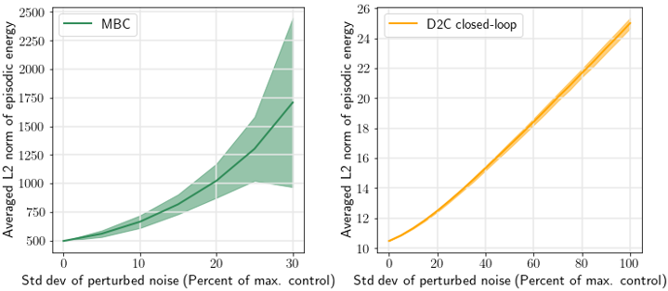
Control Energy comparison between MBC and D2C
T2D1 Tensegrity Model

Slide 16
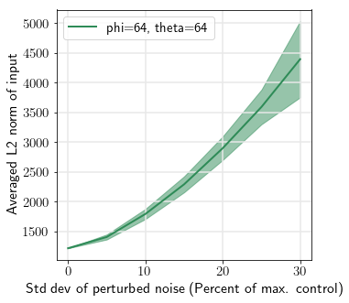
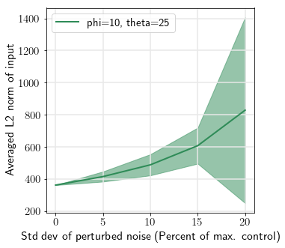
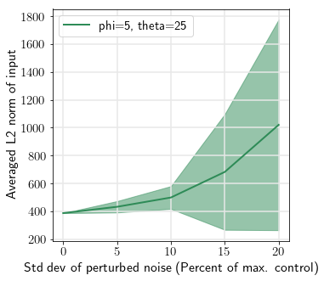
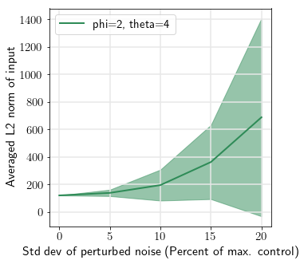
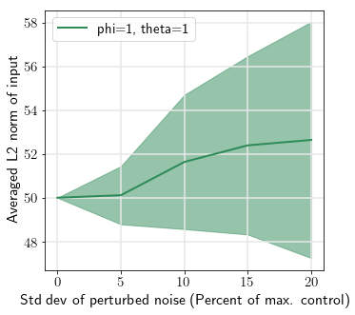
Damping ratio = 1.8
Damping ratio = 1
Damping ratio = 0.5
Damping ratio = 0.5
Damping ratio = 0.5

Slide 17
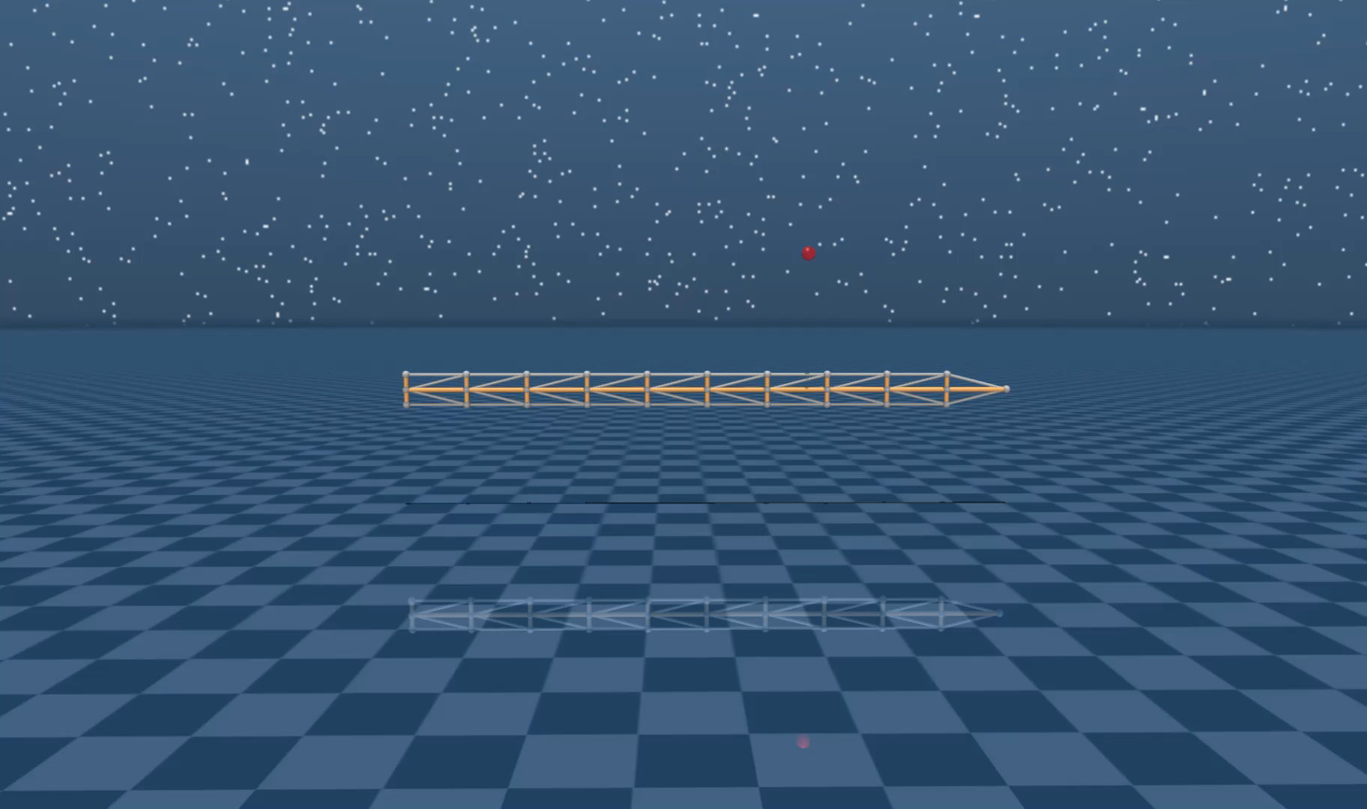
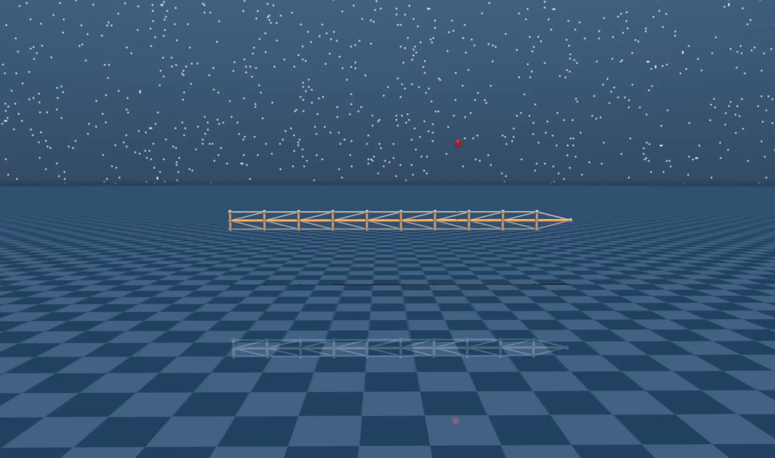
D2C applied on Robotic Arm Model
Noise level: 20%
Red Ball: Target
Failed
Succeeded
D2C open-loop policy (no feedback)
D2C closed-loop policy

Slide 18
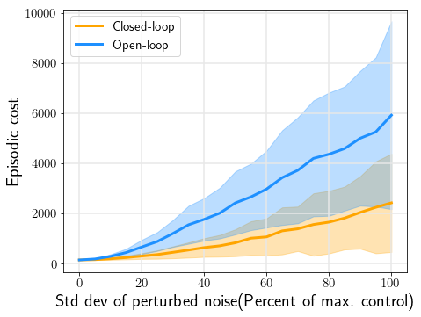
Performance comparison between D2C open-loop and closed-loop control policy
Robotic Arm Model

Slide 19
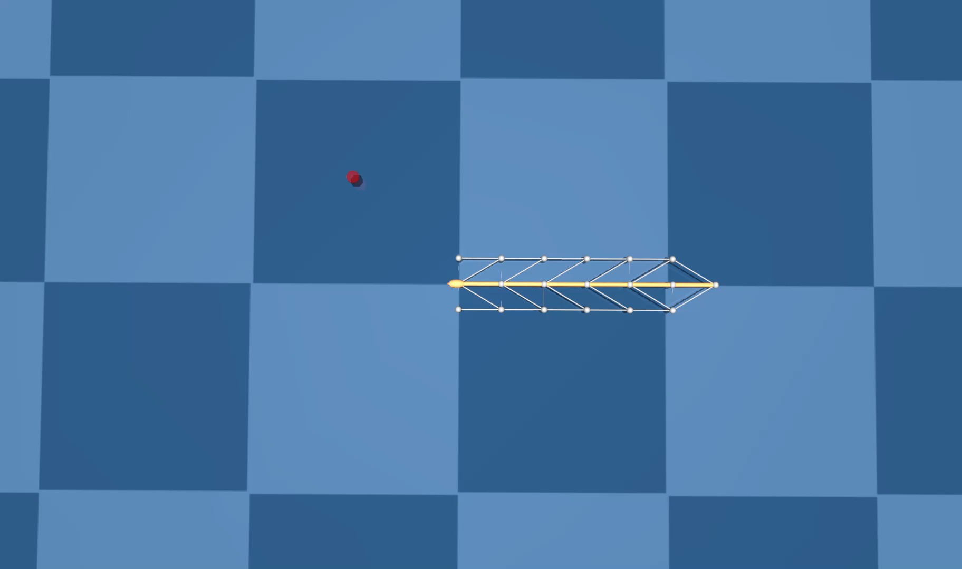

D2C applied on 6-link swimmer model
Noise level: 20%
Red Ball: Target
Failed
Succeeded
D2C open-loop policy (no feedback)
D2C closed-loop policy

Slide 20
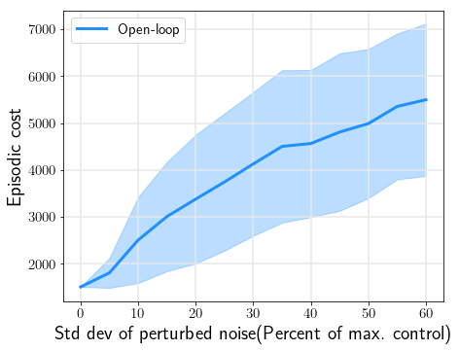
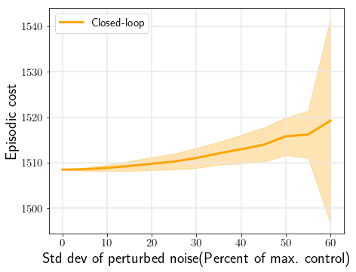
Performance comparison between D2C open-loop and closed-loop control policy
6-link Swimmer Model

Slide 21
Both the model-based shape control and D2C can drive the system to the target
Model-based shape control
Faster motion
Larger control effort
Closer to the target
Accuracy
Negligible training time
D2C
Far Less control effort
Optimization
Comparable accuracy
No need for analytical models

Slide 22
D2C Training Parameter Summary
System | Steps per rollout | Timestep (in sec.) | Rollout number per iteration | Iteration number | Training time (in sec.)
 |  |  |  |  | Open-loop | Closed-loop
Reacher | 400 | 0.01 | 300 | 1300 | 4462.1 | 4.3
Arm | 400 | 0.01 | 20 | 600 | 149.5 | 4.1
6-link Swimmer | 1500 | 0.006 | 50 | 7000 | 9204.4 | 5.8

Slide 23
Tensegrity Robot Examples

Slide 24
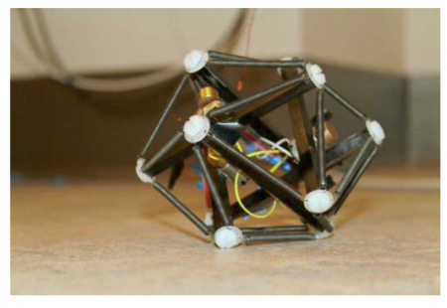
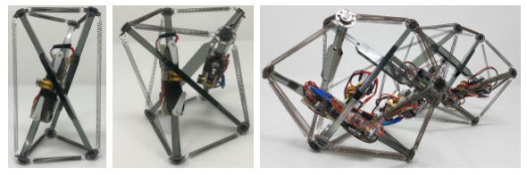
Vibration driven modular tensegrity soft robot
Dr. John Rieffel’s group, Union College
Composition: Six rigid plastic rods, 24 springs and three dc vibration motors
Control Input: Voltage for the vibration motors
Output Evaluation: Forwarding and rotation speed
Video
https://muse.union.edu/crochetlab/author/khazanom/

Slide 25
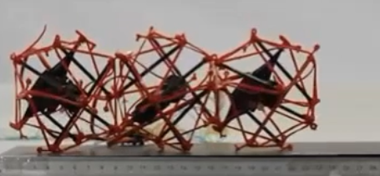
Tendon actuated crawling robot
D. Zappetti, S. Mintchev, J. Shintake, and D. Floreano
Laboratory of Intelligent Systems at Ecole Polytechnique Fédérale de Lausanne (EPFL)
Video
https://www.wevolver.com/wevolver.staff/tensegrity.soft.modular.robot/master/blob/Overview.wevolver
Composition: Three actuated modules, each has 6 bars and 24 strings
Control Input: Servo motor position cycle for contraction and expansion
Output Evaluation: Travel distance and speed

Slide 26
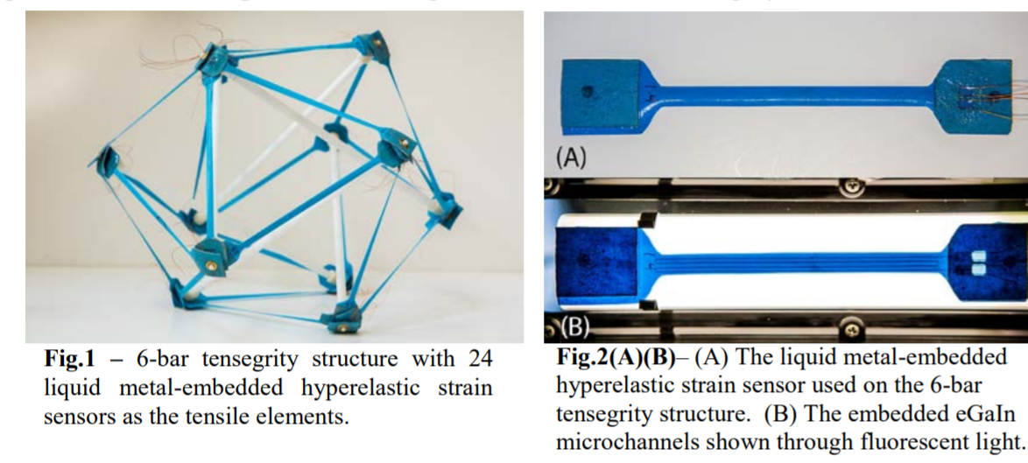
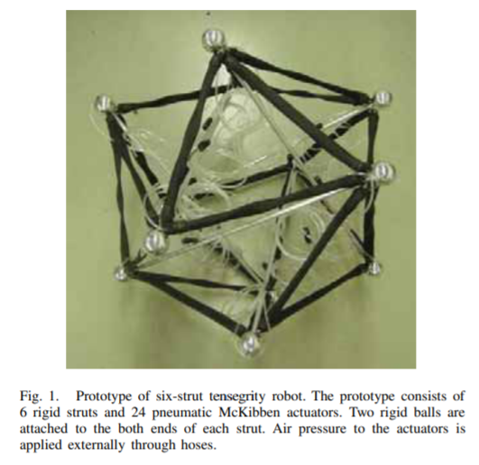
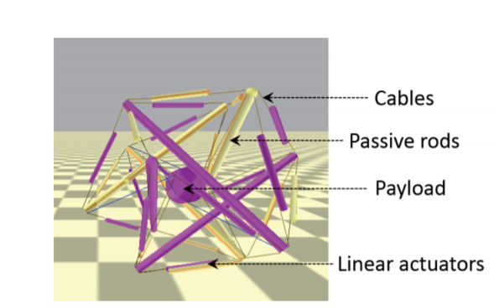
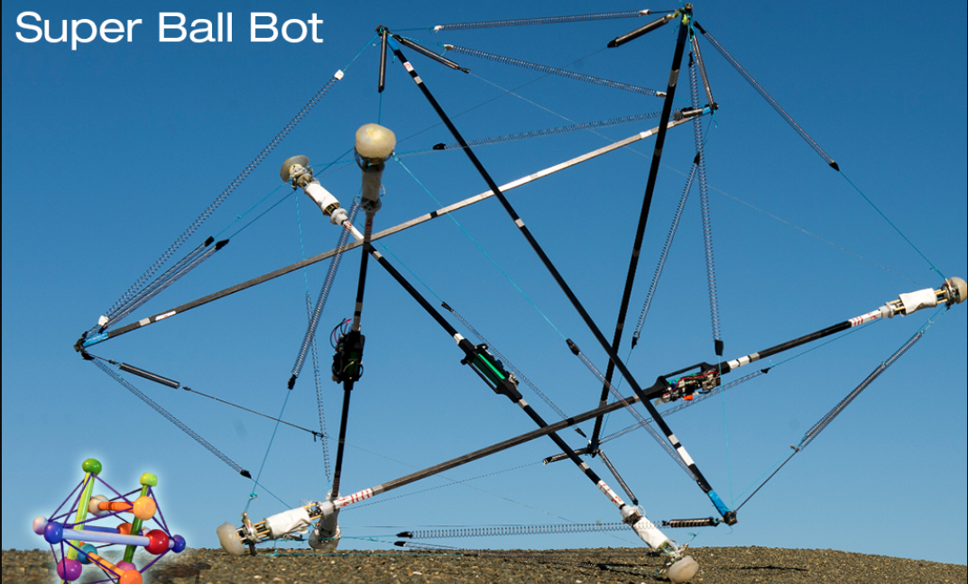
Tensegrity Ball

Slide 27
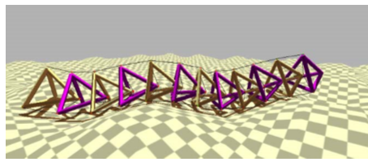
Caterpillar
Case Western Reserve University and NASA Ames
Composition: Abstracted spine segments, 6 connections between segments
Control Input: String tension controlled by impedance controller
Output Evaluation: Success in irregular terrain

